Slide 1

DS 2003: Communicating with Data
Fall 2022

Slide 2

Pre-class Survey
Please complete while I am talking.

Slide 3
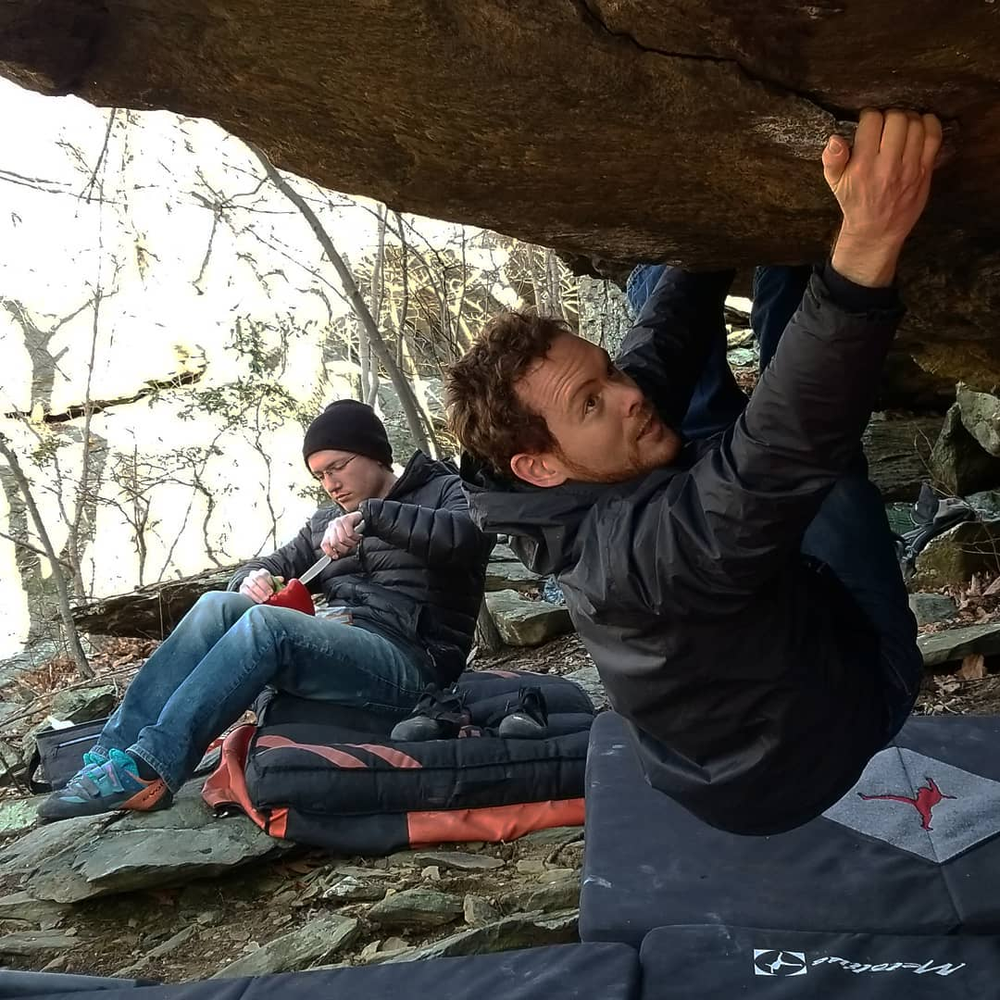
About the Instructor
Bruce Corliss (he/him/his)
PhD in Biomedical Engineering at UVA
Research is focused on scientific method (p-value alternative)
Favorite hobby: rock climbing!

Slide 4
About the TA
Shan Xu
PhD Candidate, Department of Systems and Information Engineering
Favorite hobby?

Slide 5
Course Structure
Syllabus
Grading
Expectations
Transparent Teaching Style
“Unsolicited Life Advice”

Slide 6
R/R Studio Install
Detailed instructions were sent out last week

Slide 7
Specific R Packages We Will Cover

Slide 8
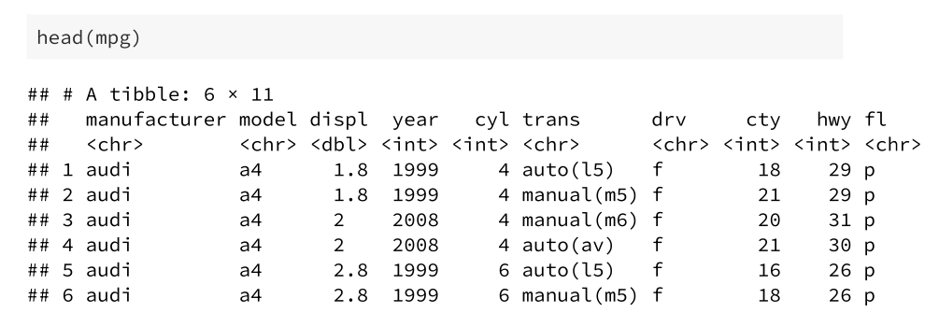
Example Data
mpg data from ggplot2 package
This dataset contains fuel economy data from 1999 to 2008 for 38 popular models of cars
Data from with 234 rows and 11 variables
For more info about mpg data, use ?mpg

Slide 9
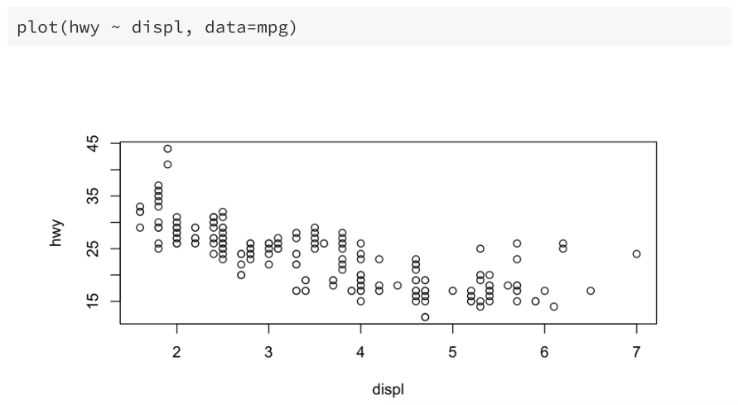
Base R
Default plotting functions like plot() and hist()
Scatterplot: engine displacement by highway miles per gallon

Slide 10
ggplot2
Ggplot2 is a system for declaratively creating graphics base on The Grammar of Graphics
Chart Visual Themes
Aesthetic Mappings
Data
ggplot2
Plot
Geometry Objects
Annotations
Scales

Slide 11
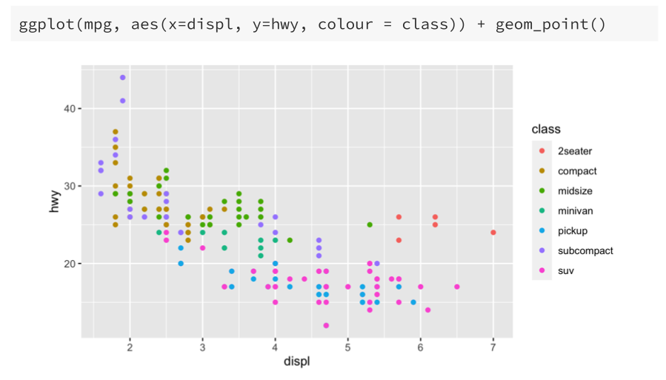
ggplot2

Slide 12
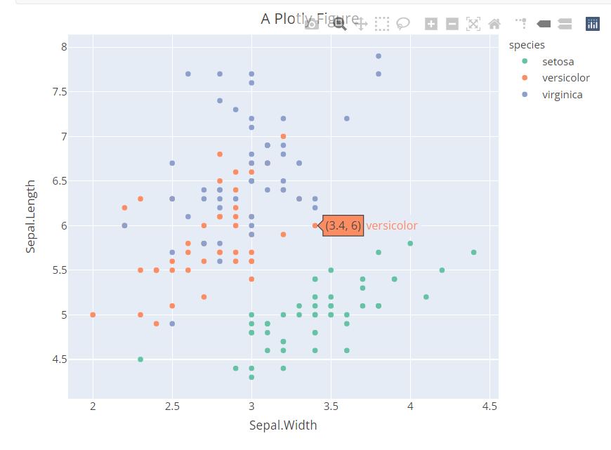
plotly
plotly is an R package for creating interactive web-based graphs

Slide 13
Shiny
Shiny is an R package that makes it easy to build interactive web applications straight from R
Example: https://youmi.shinyapps.io/curobustml/
Examples: https://shiny.rstudio.com/gallery/

Slide 14
Introduce Yourself
Major
Year
Favorite hobby

